Slide 1
Biologically-inspired
Evolutionary Artificial Neural Networks for Game AI
Modified by Drew A. Clinkenbeard
Original by Krzysztof Pietroszek

Slide 2
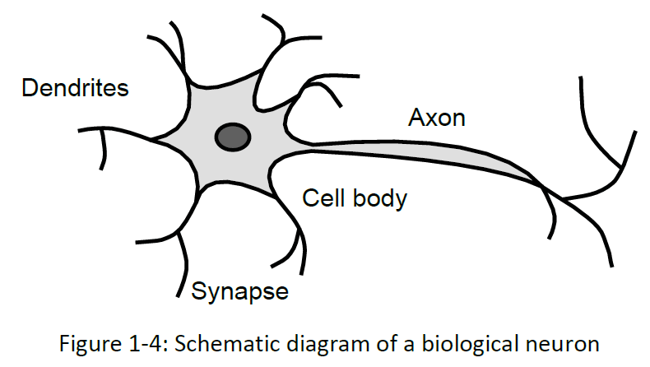
Neurons
“The human brain contains roughly 10¹¹ or 100 billion neurons. That number approximates the number of stars in the Milky Way Galaxy, and the number of galaxies in the known universe. As many as 10⁴ synaptic junctions may abut a single neuron. That gives roughly 10¹⁵ or 1 quadrillion synapses in the human brain. The brain represents an asynchronous, nonlinear, massively parallel, feedback dynamical system of cosmological proportions.”
Kosko, Bart (1992)

Slide 3
Artificial Neural Networks (ANNs)
Biological neural systems (BNSs) can model extraordinarily complex computations/functions without recourse to explicit definition, and are capable of learning over time.
BNSs reflect the ability of large ensembles of neurons to learn through exposure to external stimuli and to generalize across related instances of the signal.
ANNs are distributed, adaptive, generally nonlinear means of learning comprised of different processing elements (PEs) called neurons, that attempt to simulate BNSs.
‹#›/19

Slide 4
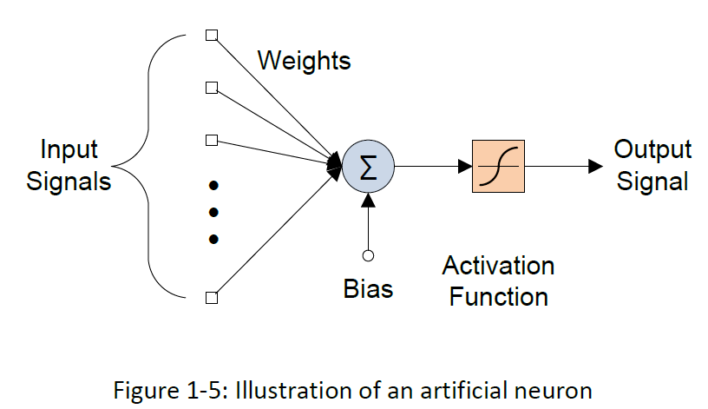
Artificial Neural Networks (ANNs)
ANN are based on a computing model that was, for a long time, believed to be similar to the underlying structure of the human brain
The aim was to model the brain’s ability to learn and/or adapt in response to external inputs.
But, “The Other Brain” research disproved the analogy recently, showing that not only neurons participate in “thinking”
Nevertheless, the model is extremely successful
Bukarica Leto, bleto@rcub.bg.ac.rs
‹#›/19

Slide 5
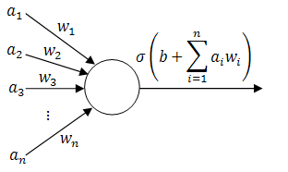
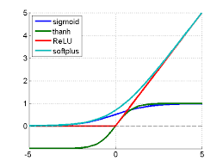
Artificial Neural Networks (ANNs)
‹#›/19

Slide 6
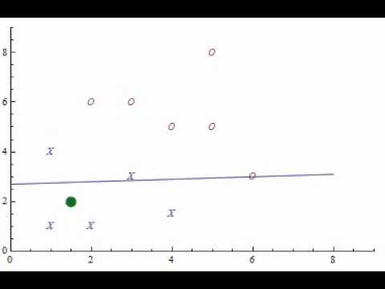

Slide 7
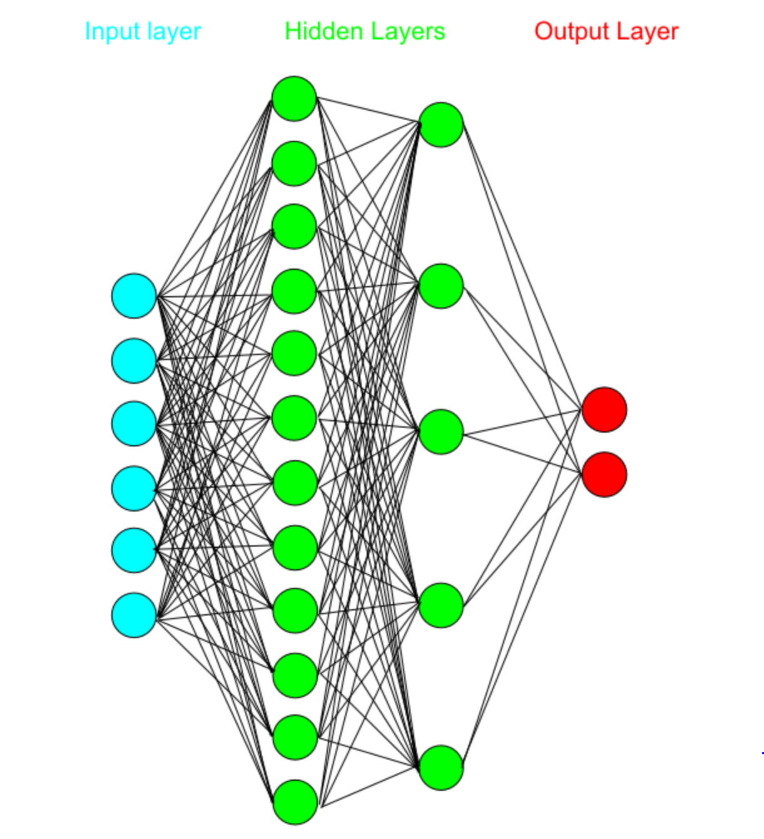

Slide 8
ANNs – Advantages
Do not require a priori knowledge about the function or even the data, which is often the opposite to traditional statistical model-based methods.
Have robustness and fault-tolerant capability.
Can perform nonlinear modeling. In fact, can approximate any continuous function with arbitrarily small error, given enough data for training.
Typically structured as parallel-processing structures, so they can be distributed into GPU cores or separate computers.

Slide 9
ANNs – Challenges
“Black-box” nature - even though they are successfully trained, no information is available from them in symbolic form, suitable for verification or interpretation by humans (although, there is new research that hopes to solve that issue)
Irrelevant variables may add extra noise which has consequential impact on the accuracy of the model
As input dimensionality increases, the computational complexity and memory requirements of the model increase

Slide 10
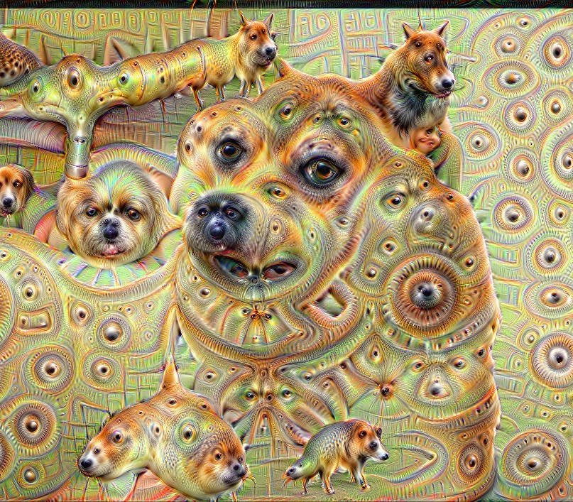
Deep Dream
Wow.
Very Confuse.
Such Unsure
So Mystery.

Slide 11
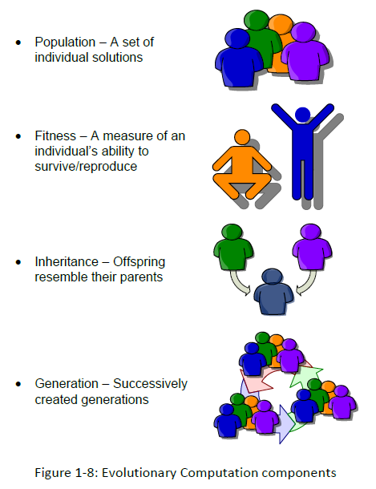
Genetic algorithms - biology
Organism has a set of rules (a blueprint) defining how it is built up from the tiny building blocks of life.
Rules are encoded in the genes, which are connected together into long strings called chromosomes.
Each gene represents a specific trait of the organism and has several different settings.
Genes and their settings are usually referred to as an organism's genotype. The physical expression of the genotype(the organism itself) is called the phenotype.
‹#›/19

Slide 12
Genetic algorithms - biology
When two organisms mate, their resultant offspring ends up having shared genes - recombination.
Occasionally a gene may be mutated.
Life on earth has evolved to be as it is through the processes of natural selection, recombination and mutation.
‹#›/19

Slide 13
Genetic algorithm (GA)
Before using a GA to solve a problem, a way must be found of encoding any potential solution to the problem. This could be as a string of real numbers or, more typically, a binary string. It is referred to as the chromosome. A typical chromosome may look like this: 10010101110101001010011101101
At the beginning of a run a large population of random chromosomes is created. Each one, when decoded will represent a different solution to the problem at hand. Let's say there are N chromosomes in the initial population.
Bukarica Leto, bleto@rcub.bg.ac.rs
‹#›/19

Slide 14
Genetic algorithm (GA)
The following steps are repeated until a solution is found:
Test each chromosome to see how good it is at solving the problem at hand and assign a fitness score accordingly. The fitness score is a measure of how good that chromosome is at solving the problem to hand.
Select two members from the current population. The chance of being selected is proportional to the chromosomes fitness. Roulette wheel selection is a commonly used method.
Dependent on the crossover rate crossover the bits from each chosen chromosome at a randomly chosen point.
Step through the chosen chromosomes bits and flip dependent on the mutation rate.
Repeat steps 2, 3, 4 until a new population of N members has been created
‹#›/19

Slide 15
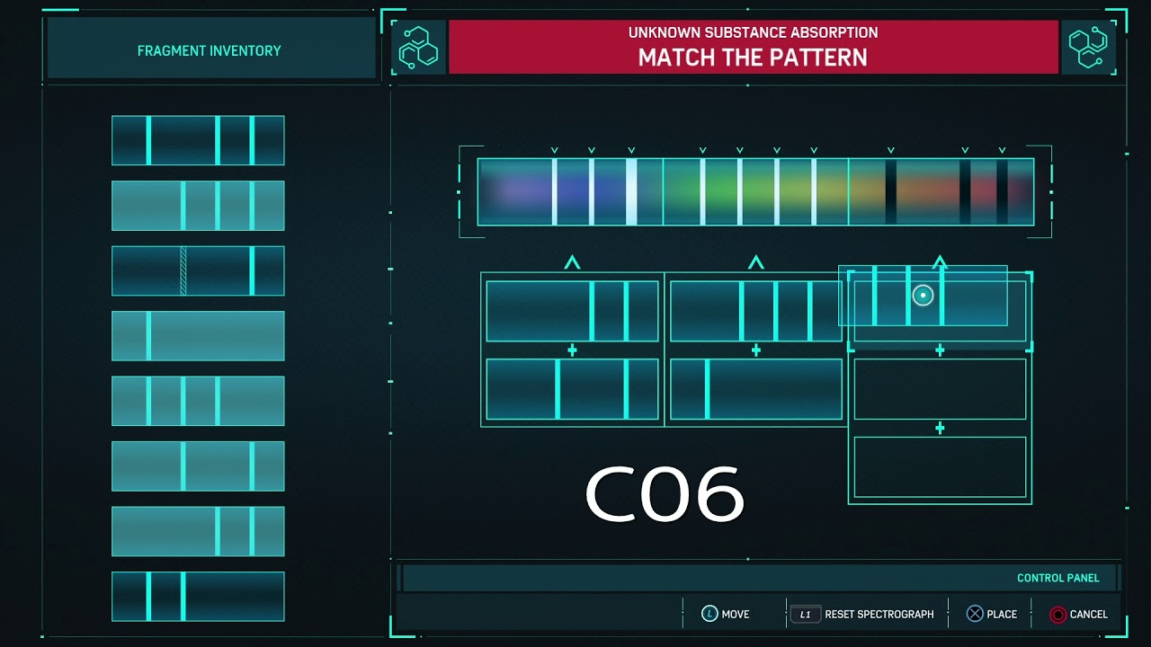

Slide 16
GA + ANN = EANN
Biological neural networks
Natural evolution
Artificial intelligence
Optimization and search problems
Artificial neural networks (ANN)
Genetic algorithms (GA)
Evolving Artificial Neural Networks

Slide 17
Learning vs. Evolution
Learning and evolution are two fundamental forms of adaptation.
They differ in space, time, and substrate.

Slide 18
Evolution
Requires a population (often geographically-distributed) displaying some variability.
Is a process of selective reproduction and substitution.
Captures relatively slow environmental changes, i.e., over several generations.
Evolution operates on the genotype, i.e., the genetic specification of an individual.

Slide 19
Learning
Set of modifications taking place within a single individual during its own lifetime.
Humans display an exceptional capacity to learn.
It takes a very long time to reach maturity.
Allows to adapt to “fast” changes in the environment.
Learning only affects the phenotype, i.e., the decoded and embodied version of an individual.

Slide 20
Learning (cont.)
Phenotypic changes cannot directly modify the genotype.
However, learning can influence evolution (Baldwin Effect).
Learning and development interact in an important and non-obvious way.

Slide 21
What are the benefits of EANN for the engineer?
Automate the design of artificial neural networks.
Help solving “hard” problems.
Combination of ANN’s and EA’s can lead to significantly better intelligent systems than on relying on ANN’s or EA’s alone.

Slide 22
ANN Parameters
Connection weights
Transfer function
Topology (i.e., interconnections)

Slide 23
Learning in ANNs
corrective learning
supervised learning
learning
reinforcement learning
unsupervised learning
Essence: (learning rule, Hebb-rule, etc.)
i.e.
weight-updating rule

Slide 24
Learning in ANNs (cont.)
Supervised learning: minimization of an error.
Unsupervised learning: based on the correlations among input data.
Reinforcement learning: special case of supervised learning where the exact output is not known (“learning what to do”).
Corrective learning: the magnitude of an error, together with the input vector, determines the magnitude of the correction to the weights.

Slide 25
Evolutionary Algorithms (EA)
Class of population-based stochastic search algorithms inspired by natural evolution.
Individuals compete and exchange information in order to perform certain tasks.
EAs are good for complex and hard problems with local minima.
Fitness function required (for almost all algorithms), but EAs do not depend on gradient information and also work with non differential error functions.

Slide 26
Evolving Artificial Neural Networks:
What can be Evolved?
Connection weights
Architectures (including transfer functions)
Learning rules (“learning to learn”)
However, it is better not to employ EAs at all possible levels (architecture, weights, learning rules) of evolution. Why?

Slide 27
Example: Network Encoding
Christof Teuscher
node 1 node 2 node N
1 | 2 | 3
4 | ...
gene
... network genome
a
b
number of node a number of node b
n
v
value v of node 1
node 1
node 2
node 3
node 4
node 5
2 | 3 | 1
3 | 5 | 1
4 | 5 | 0
3 | 4 | 0
network genome
2 | 5 | 1
1
2
3
4
5

Slide 28
Representations
Binary representation: A connection weight is represented by a number of bits with a certain length.
Binary representations are simple and easy to use (crossover, mutation, hardware implementation).
Real-Number Representation: A connection weight is
represented by a real number and traditional binary
crossover and mutation can no longer be used directly.

Slide 29
How EAs modify different aspects of a ANN

Slide 30
The Evolution of Architectures
Architecture design is still very much a human expert’s job.
There is no systematic way to design near-optimal architectures for a given task automatically.

Slide 31
The Evolution of Architectures (cont.)
Decode each individual in the current generation into an architecture.
Train each ANN with the decoded architecture by a predefined learning rule starting from a different set of random initial connection weights and parameters.
Compute the fitness of each individual.
Select parents from the population based on their fitness.

Slide 32
The Evolution of Learning Rules
Decode each individual in the current generation into a learning rule.
Construct ANNs with random architectures and initial settings and train them using the decoded learning rule.
Evaluate the fitness of each individual.
Select parents.
Generate offsprings using mutation and crossover.

Slide 33
Evolutionary Training (ET) versus Gradient-Based Training (GBT)
ET can handle global search problems better in a vast, complex, and non differentiable surface.
ET does not depend on gradient information of the error function.
ET can be very slow in comparison with fast variants of BP.

Slide 34
Evolutionary Training (ET) versus Gradient-Based Training (GBT) (cont.)
EAs are less sensitive to initial conditions of training. They always search for a global optimum.
In general, hybrid algorithms tend to perform better than others for a large number of problems.

Slide 35
Hybrid Training
Most EAs are rather inefficient in fine-tuned local search.
EAs can be used to locate a good region in space and then a local search procedure (e.g., BP) is used to find a near-optimal solution in this region.

Slide 36
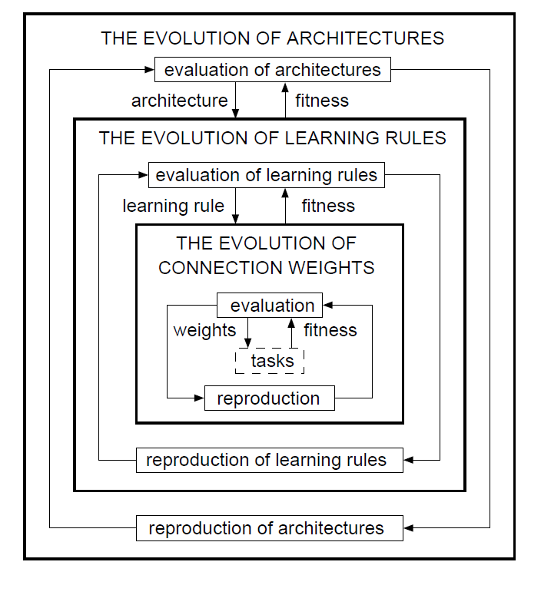
A General Framework for EANNs

Slide 37
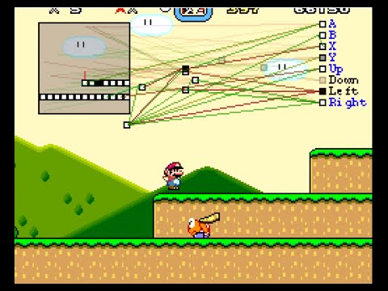

Slide 38
A General Framework for EANNs (cont.)
The evolution of connection weights proceeds at the lowest level on the fastest time scale in an environment determined by an architecture, a learning rule, and learning tasks.
However, the evolution of architectures can also be at the lowest level if there is less prior knowledge available than about the connection weights (knowledge can be encoded to reduce the search space).

Slide 39
Conclusions and Problems
Permutation or competing convention problem: many-to- one mapping from the genotype to the phenotype (ANN). Different genomes can result in functionally equivalent net- works. The permutation problem makes crossover very inefficient in producing good offsprings.
Separating the evolution of architectures and that of connection weights can make fitness evaluation inaccurate and mislead evolution. Better use simultaneous evolution.

Slide 40
Conclusions and Problems (cont.)
Global search procedures such as EAs are usually computationally expensive.
Possible acceleration: Evolutionary Hardware.
Evolution can be introduced into ANNs at many different levels.
Evolution of the weights is useful when gradient information of the error function is difficult or costly to obtain.

Slide 41
Conclusions and Problems (cont.)
Evolution can be used to find a near-optimal ANN architecture automatically.
Evolution discovers possible new ANN architectures.
From an engineering point of view, the decision on the level of evolution depends on what kind of prior knowledge is available.
Most solutions are problem specific!

